Slide 1
WEB MVC Framework
--process this topic to show a way about learning open source
Zicheng Pan / EE-CN-42

Slide 2
Zicheng-Pan
Shanghai
EE-CN-42
FT Lambda (AD Backend)
Since 19/12 came to BMW. For now more than 2 years
Java, Python, DB, AWS, Big Data.
Use less and less line number of code but build more and more high available, more and more high concurrency project.
Part-time job : take a baby.
As a father and developer. So if you also have a baby or you have some confusion about the micro service, do not hesitate to contact with me. I am pleasure to supply my knowledge.

Slide 3
By this sharing we can get:
Learn how to use web framework to build a simple http project.
How to design your web mvc framework.
Summarize the routine about the web framework, and it is easy for you to learn or build web project by another program language or other web framework.

Slide 4
Introduction: web framework
HTTP server:
A program running on the remote machine by using http protocol to provide a web server. Such as [Apache, IIS, Nginx, Tomcat…].
The benefit about using a web framework:
Scalability: easy to build, use and add your business module.
[reduce the cost of use]
2. To reduce the complexity of interdependence.
[reduce the cost of maintenance]

Slide 5
Build first web project
Introduction about flask:
Flask is a micro web framework written in Python.
Flask是一个轻量级的可定制框架，使用Python语言编写，较其他同类型框架更为灵活、轻便、安全且容易上手。它可以很好地结合MVC模式进行开发，开发人员分工合作，小型团队在短时间内就可以完成功能丰富的中小型网站或Web服务的实现。另外，Flask还有很强的定制性，用户可以根据自己的需求来添加相应的功能，在保持核心功能简单的同时实现功能的丰富与扩展，其强大的插件库可以让用户实现个性化的网站定制，开发出功能强大的网站。From site: baike.baidu
KEY POINTS:
flexible, lighter, safer, easier
Notes:
灵活简单小

Slide 6
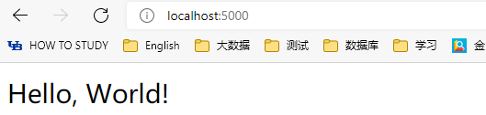
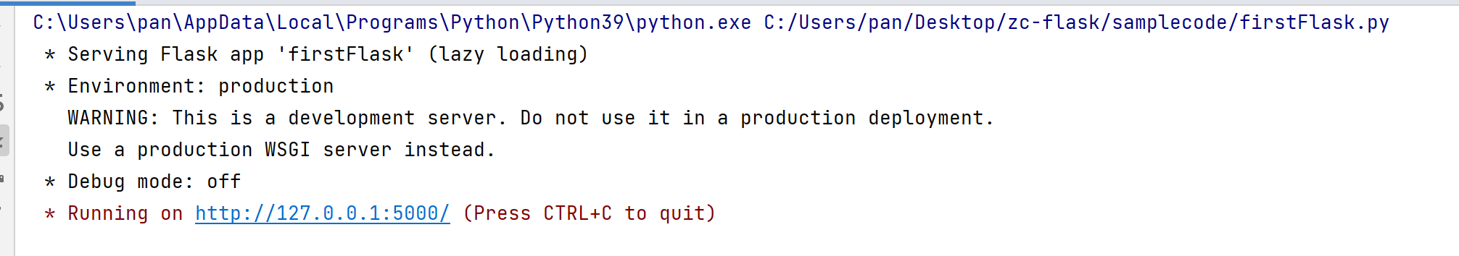
Tested for the first time[小试牛刀]
1. Pip install flask [add flask dependency]
2. Copy & Past code below:
from flask import Flask app = Flask(__name__)
@app.route("/") def hello_world(): return "<p>Hello,World!</p>"

Slide 7
The preparation:
Before we start to build our MVC frame work, we should:
1. we need a program which can parse the HTTP protocol.
2. we need to open the network connection to let others visit.
3. customer can request the URL and get the response.
………
due to the complex about the process, we use WSGI [which is also used by
Flask] to quickly to build the initial our project.

Slide 8
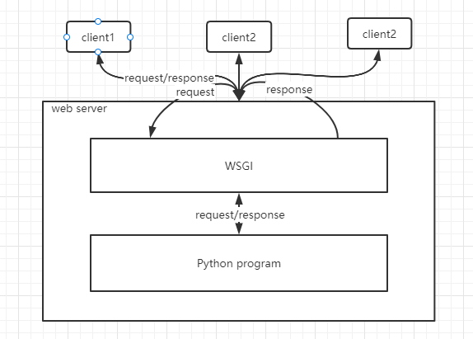
WSGI [Web Server Gate Interface]
WSGI you can regarded as a tool
which packed the HTTP server and
HTTP protocol parsing.
[easy for us to quick build our own
web project, PS: you can use SOCKET
the raw network program tool to cover
the WSGI]

Slide 9
Build entry point by WSGI
from werkzeug.wrappers import Request def wsgi_app(app, environ, start_response):
request = Request(environ) response = app.dispatch_request(request)
return response(environ, start_response)
the main process is that:
We use WSGI to transform the HTTP request
Byte or Text content to WSGI Request Object.
Then, By our program [app object] to
handle the request to get the final result response.

Slide 10
Create my Entry Point
from werkzeug.serving import run_simple from werkzeug.wrappers import Response from wsgi_adapter import wsgi_app class WEBMVC: def __init__(self): self.host = "127.0.0.1" self.port = 8080 def dispatch_request(self,request): status = 200 headers = { 'Server': 'hello webserver' } return Response('<h1>Hello, Framework</h1>', content_type='text/html', headers=headers, status=status) def run(self, host=None, port=None, **options): for key, value in options.items(): if value: setattr(self, key, value) if host: self.host = host if port: self.port = port run_simple(hostname=self.host, port=self.port, application=self, **options) def __call__(self, environ, start_response): return wsgi_app(self, environ, start_response)
Main.py
from zcflask import WEBMVC app = WEBMVC() app.run(use_reloader=True)

Slide 11
Observe the method we use
from flask import Flask app = Flask(__name__)
@app.route("/") def hello_world(): return "<p>Hello,World!</p>“
We can find we need a relation between the URL and the approach
@app is the closure method in python. [java means annotation]

Slide 12
Add relationship between URL and approach
def add_url_role(self, url, func, func_type, endpoint=None, **options): if endpoint is None: endpoint = func.__name__ if url in self.url_map: raise exceptions.URLExistsError if endpoint in self.function_map and func_type != 'static': raise exceptions.EndpointExistsError self.url_map[url] = endpoint self.function_map[endpoint] = ExecFunc(func, func_type, **options)
func_type contains such as route [raw method], static [CSS, HTML, JS,IMG…], view… lots of details you can search later.
But now, we can ignore it.
Just remember there is map contains the relation between the URL and handle function.
The endpoint is the uniquely identifies [here we use the request name as the endpoint such as /getUserName].

Slide 13
Handle the request
def dispatch_request(self, request): headers = { 'Server': 'ZC Flask 0.1' } url = request.base_url.replace(request.host_url, '/') if url.startswith('/' + self.static_folder + '/'): endpoint = 'static' url = url[1:] else: endpoint = self.url_map.get(url, None) if endpoint is None: return ERROR_MAP['404'] exec_function = self.function_map[endpoint] exec_type = exec_function.func_type if exec_type == 'route': rep = self.do_route_process(request, exec_function) elif exec_type == 'static': return exec_function.func(url) elif exec_type == 'view': rep = exec_function.func(request) else: return ERROR_MAP['503'] content_type = 'text/html; charset=UTF-8' status = 200 return Response(rep, content_type=content_type, headers=headers, status=status)
def dispatch_static(self, static_path): if not os.path.exists(static_path): return ERROR_MAP['404'] key = parse_static_key(static_path) file_type = TYPE_MAP.get(key, "test/plain") with open(static_path, 'rb') as f: data = f.read() return Response(data, content_type=file_type)

Slide 14
In-deep thinking:
Before we talk about the :
The benefit about using a web framework:
Scalability: easy to build, use and add your business module.
[reduce the cost of use]
2. To reduce the complexity of interdependence.
[reduce the cost of maintenance]
The situation:
The benefit about using a web framework:
If I want to change the handle method about the URL “/index”, I need to delete all the method and rebuild our whole project.
If I want to add access control in all URL handler. Then I need to change more.
So we need the MVC framework.

Slide 15
View:
class View: method = [] methods_meta = {} def dispatch_request(self, request, *args, **options): raise NotImplementedError @classmethod def get_func(cls, name): def func(*args, **kw): return cls().dispatch_request(*args, **kw) func.__name__ = name func.__doc__ = cls.__doc__ func.__module__ = cls.__module__ func.methods = cls.methods return func
class BaseView(View): methods = ['GET', 'POST'] def post(self, request, *args, **options): pass def get(self, request, *args, **options): pass def dispatch_request(self, request, *args, **options): if request.method in self.methods: func = getattr(self, request.method.lower()) return func(request, *args, **options) return '<h1>Unknown or unsupported require method.</h1>'
Attention:
View handle method is also dispatch_request
For flexible view need to be inherited, so it is a class
In Java it looks like bean Introspector [Java Bean 自省]

Slide 16
Controller:
class GetView(BaseView): def get(self, request): return 'get view' class PostView(GetView): def post(self, request): return "post view" view_map = [ { 'url': '/index/view/get', 'view': GetView, 'endpoint': 'getindex' }, { 'url': '/index/view/post', 'view': PostView, 'endpoint': 'postindex' } ] index_controller = Controller('index', view_map) app.load_controller(index_controller) app.run(use_reloader=True)
class Controller: def __init__(self, name, url_map): self.name = name self.url_map = url_map
Attention:
Controller just is a bulk bind the URL and View
This is good for user to reuse the Code and decoupling

Slide 17
Load Controller & bind view:
class View: method = [] methods_meta = {} def dispatch_request(self, request, *args, **options): raise NotImplementedError @classmethod def get_func(cls, name): def func(*args, **kw): return cls().dispatch_request(*args, **kw) func.__name__ = name func.__doc__ = cls.__doc__ func.__module__ = cls.__module__ func.methods = cls.methods return func
def bind_view(self, url, view_class, endpoint): func = view_class.get_func(endpoint) self.add_url_role(url, func=func, func_type='view’)
def load_controller(self, controller): for rule in controller.url_map: self.bind_view(rule['url'], rule['view'], controller.name + '.' + rule['endpoint'])
before
Attention:
This step is to transfer the controller into the URL and Approach relation map.

Slide 18
The last Model & Template:
class RenderTemplate(BaseView): def get(self, request): return simple_template("index.html", user="testUser", message="hello world")
import os import re pattern = r'{{(.*?)}}' def parse_args(obj): comp = re.compile(pattern) result = comp.findall(obj) return result or () def replace_template(app, path, **options): content = '<h1>Not Found Template.</h1>' path = os.path.join(app.template_folder, path) print(str(path)) if os.path.exists(path): with open(path, 'rb') as f: content = f.read().decode() args = parse_args(content) if options: for arg in args: key = arg.strip() old_value = '{{{{{}}}}}'.format(arg) new_value = str(options.get(key, '')) content = content.replace(old_value, new_value) return content
Attention:
Use regular express to replace the pattern.
Model using in view is also can reuse.

Slide 19
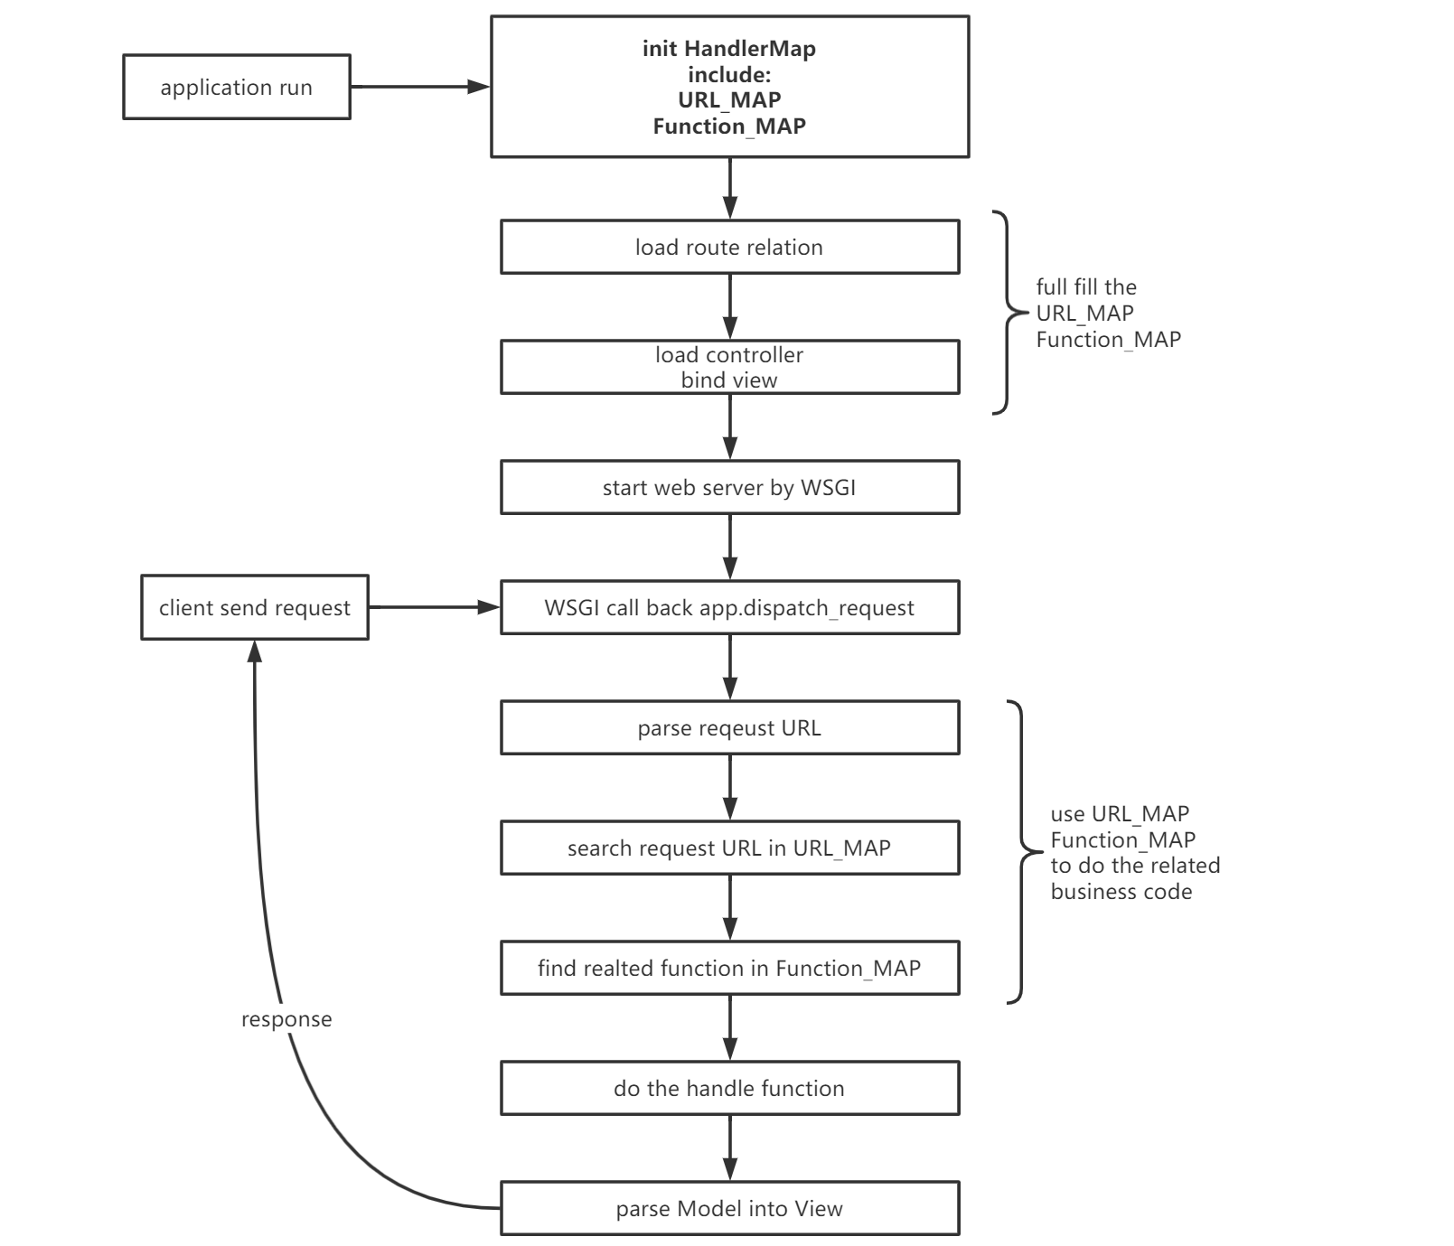
The process to build the MVC framework:

Slide 20
Review the process to build the MVC framework:
You may noticed that in the process every point we can find the related skills in Java.
Does it mean in Spring web MVC framework is the same structure?
What is the difference between Flask and Spring framework?
In web.xml --- from servlet specification
<servlet-mapping> <servlet-name>dispatcherServlet</servlet-name> <url-pattern>/</url-pattern> </servlet-mapping>
<servlet> <servlet-name>dispatcherServlet</servlet-name> <servlet-class>org.springframework.web.servlet.DispatcherServlet</servlet-class> <init-param> <param-name>contextConfigLocation</param-name> <param-value>classpath:webApplicationContext.xml</param-value> </init-param> <load-on-startup>1</load-on-startup> </servlet>
So we stared from DispatcherServlet

Slide 21
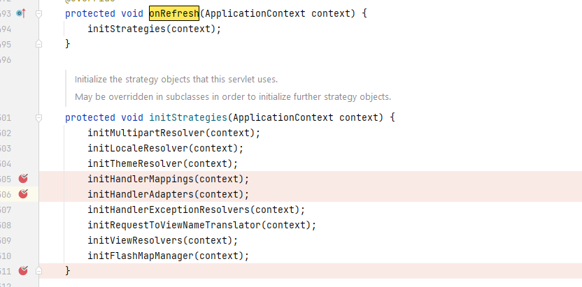
In DispatcherServlet after Tomcat Start will call in iniStrategies

Slide 22
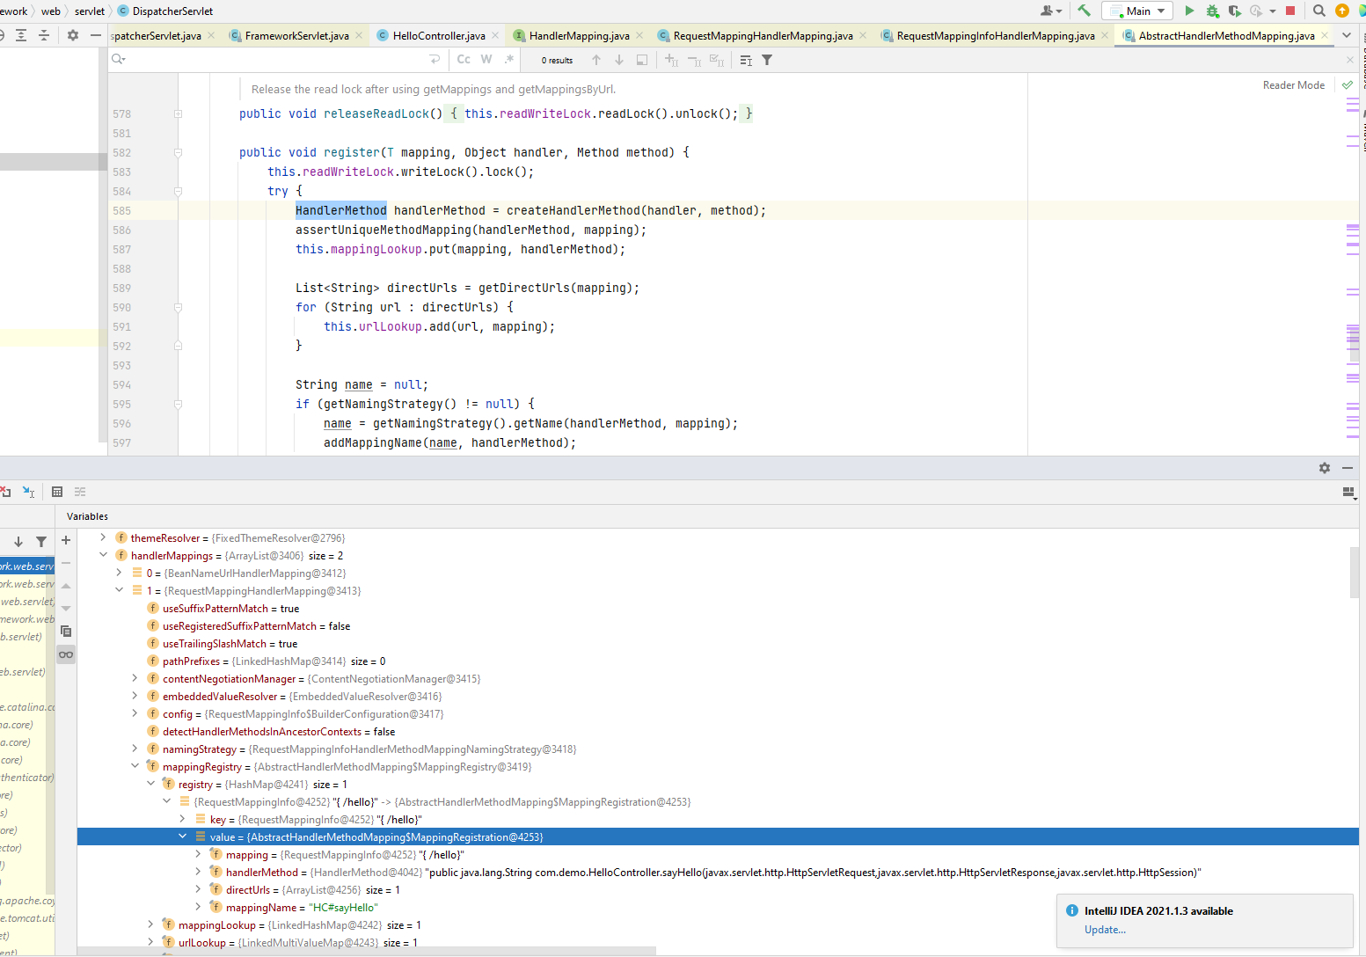
initHandlerMappings
HandlerMethod is the method Object
The process about Build the relation Map is the same.
After initHandlerMappings

Slide 23
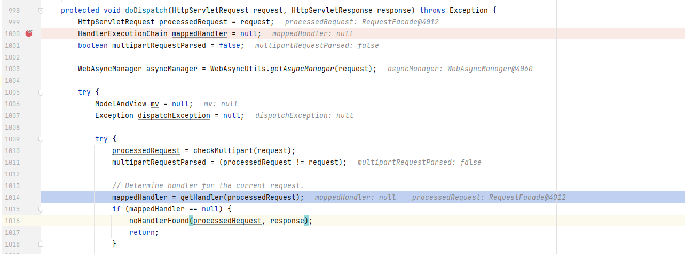
In handling the request [doDispatch method in DispatcherServlet]

Slide 24
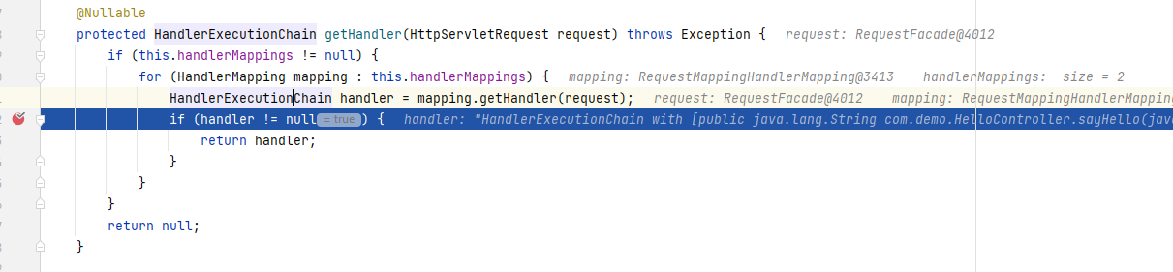
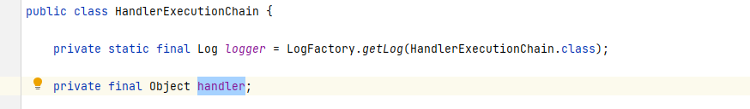

Slide 25
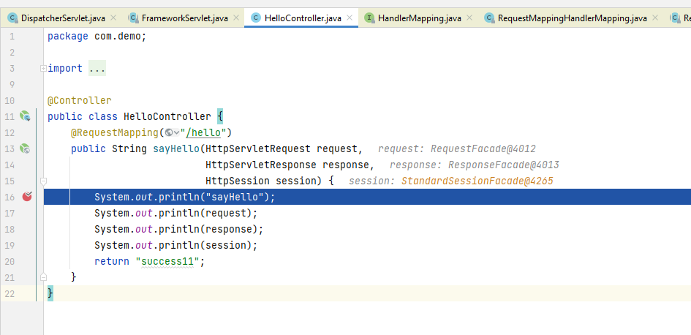
Finally
The same as Flask View in Spring MVC is ModelAndView
org.springframework.web.servlet.mvc.method.annotation.RequestMappingHandlerAdapter#getModelAndView

Slide 26
In the end:
大家都说读源码很难，学习开源框架的代码的确很难，很多时候都是我们的出发点有问题，盲目的为了读而读就陷入了误区，结果事半功倍，我们可以从简单的出发+自己的假设猜想，带着问题来学习源代码，通过这种方式我们可以从几百行的Flask的框架代码中学习到的架构理念，来通读spring mvc 的代码，这个过程让我认识到，在实际项目中很多技术或者是本质都是相通的，其实很多开源框架也是类似的。看似学无止境，实际上我们只要关注自己的增量，所有看起来很难得事情，只要一点一滴积累起来，最终都可以做到水到渠成。

Slide 27
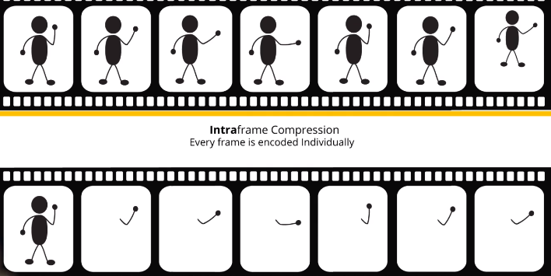
Movie – Interframe compression帧间压缩
Notes:
1920*1080P的电影人眼一秒至少刷新24帧
RGB 三原色 一个像素三个字节
2小时*60分钟*60秒*25帧*1920*1080*3 ~大概1119.8GB ----》非常的大，所以网络上的视频都需要进行压缩
压缩到几千倍，但是看起来还是很流畅【关注信息增量而不是信息存量来提高效率】
关注变化，忽略重复，提升自己的效率
第一个小人特别的重要--》读书也是越基础理论的书，越花费大量的时间去阅读---》相关的基础知识一定要打牢，才可以做到快速阅读，快速学习

Slide 28
Thanks
从秒杀系统谈架构设计
云原生

